Slide 1
Cybersecurity and Elections

Slide 2
Introduction
Andrew Ray – andrew.ray@anu.edu.au
Notes:
Personal capacity

Slide 3
Focus of Lecture
Federal jurisdiction – how does voting work
Direct cyber threats
What happens if someone succeeds?
Indirect cyber threats
Misinformation and disinformation
Future technologies
Principles for reform

Slide 4
What will not be covered in depth
Foreign interference (directly)
See Foreign Influence Transparency Scheme
Foreign Influence Transparency Scheme Act 2018

Slide 5
How does voting work?
Lower house – preferential voting (candidate with lowest count eliminated and votes redirected based on preferences)
Upper house – preferential voting system based on quota
1. Votes distributed to first preferences
2. Any surplus votes distributed to second preferences of each paper at the transfer value
3. Lowest candidate eliminated and votes distributed to next preference for each ballot paper.
4. Any preferences that flow to elected senators distributed to next preference using the transfer value

Slide 6
Exhausted votes
“A vote is considered "exhausted" when there is no next available preference for any continuing candidate meaning that it must be set aside from the scrutiny at that point.”

Slide 7
Senate
Quota = (Number of formal ballot papers / (Number of senators to be elected + 1)) rounded down + 1
Eg ACT (est) (300,000/(2 + 1)+ = 100,000
Rounded down + 1 = 100,001
Transfer value = Surplus / Number of votes for candidate
Eg if ACT candidate received 120,000 votes the transfer value for each second preference would be ~.20
Surplus = Number of votes - Quota

Slide 8
Worked example of the Senate Count ACT

Slide 9
What do we mean by direct threats?

Slide 10
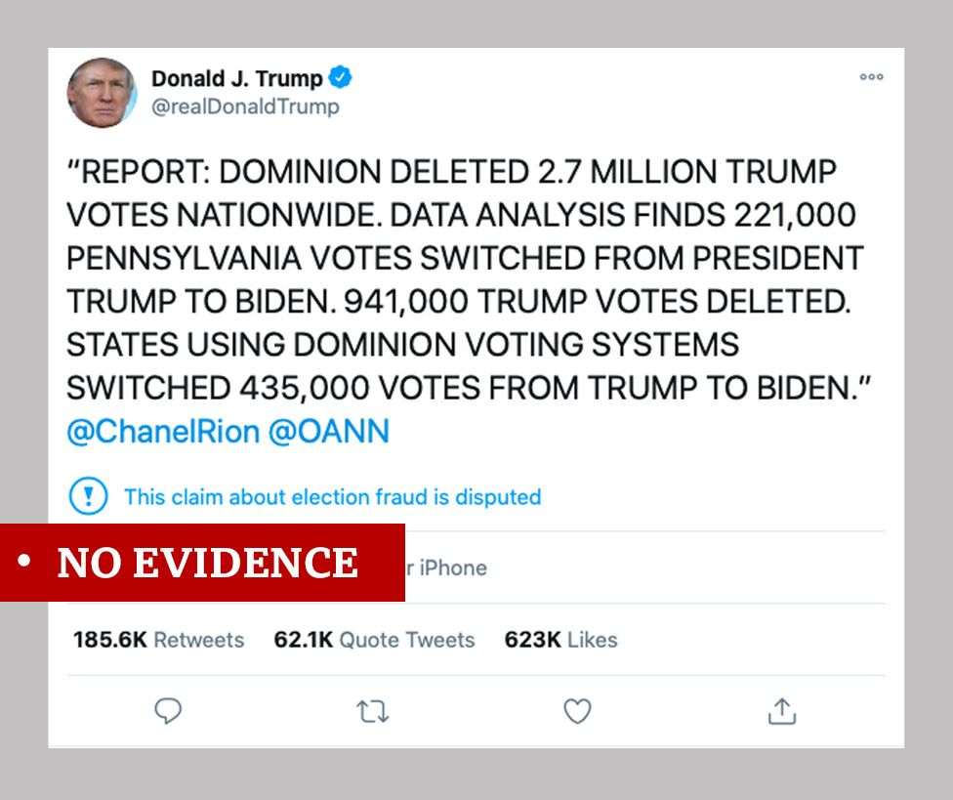
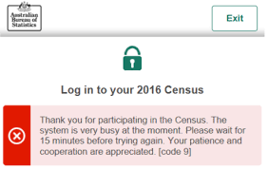
What do we mean by direct threats?
Altering/falsifying election results;
Attacking an electronic voting system to prevent voting;
Or other cyber threat that prevented voting on the day (ie. shutting down a train network)

Slide 11
Can a direct cyber attack impact a Federal Election?

Slide 12
Can a direct cyber attack impact a Federal Election?
No
AEC uses manual counting for all lower house seats and only partially automates the counting for the senate.
Every vote is counted and verified by multiple AEC employees and the parties are permitted to have scrutineers to check the ballots.

Slide 13
What do we mean by direct threats?
Altering/falsifying election results;
Attacking an electronic voting system to prevent voting;
Or other cyber threat that prevented voting on the day (ie. shutting down a train network)

Slide 14
What happens if someone succeeded?
360 Powers of Court
(1) The Court of Disputed Returns shall sit as an open Court and its powers shall include the following:
…
(v) To declare that any person who was returned as elected was not duly elected;
(vi) To declare any candidate duly elected who was not returned as elected;
(vii) To declare any election absolutely void;

Slide 15
What happens if someone succeeded?
NSW Electoral Commissioner v Kempsey Shire Council (No 2) [2022] NSWSC 282
NSW iVote system crashed on the day of the 2021 council elections, preventing a small number of electors in certain council wards from casting a vote.
Evidence from AEC was that the number of votes could impact the three council results in the case; evidence from a different expert called by one of the councillors was that a greater number of results were in question.
Issue for the NSW Supreme Court was whether a new poll had to be held.

Slide 16
The test the Court applies
At [75]:
Regardless of the basis upon which these Courts have considered the matter, they all accept that … there is some threshold of materiality which must be overcome before relief will be granted voiding an election in whole or in part by reason of a breach of a statutory requirement pertaining to the election. If it was necessary to decide I would consider myself bound to subsume the discussion of breaches of statutory provisions concerning elections in the above cases into the framework of Project Blue Sky, Hossain and MZAPC. However, in the end result it is not necessary to go that far. The threshold is certainly above the mere existence of a bare possibility and below more likely than not that a different result would have ensued. For the reasons set out below, within that range, the various formulations, including that the result of the election is rendered uncertain, are all satisfied in this case. In view of the evidence that was adduced any relevant onus was discharged.

Slide 17
[83] …I consider that the better analysis is … a comparison of the various margins between candidates at the exclusion points including the last count and the number of excluded voters, …This approach is akin to that suggested by Dr Teague.
[84] In the case of Shellharbour City Council-Ward A the (maximum) number of disenfranchised iVoters was 54 and the margin between the last two candidates was four votes. Even making allowance for the potential for a number of the 54 voters not to have yielded formal votes, I am satisfied that the breach of regulation 333E was material to the outcome of the election …
[85] In the case of Kempsey Shire Council, the (maximum) number of disenfranchised iVoters was 34 which was equal to or exceeded the margins between excluded candidates in the fourth count (two votes), the fifth count (25 votes), the sixth count (19 votes), the 12th count (two votes), the 17th count (34 votes) and the 18th count (31 votes). Even making allowance for the potential for a number of the 34 iVoters not to have cast formal votes, I am satisfied that the breach of regulation 333E was material to the outcome of the election …
[86] In the case of Singleton Council, the (maximum) number of disenfranchised iVoters was 55 which was much greater than the difference between the progressive total of the two candidates elected in the last round of counting and that of the last remaining candidate left on that count (55 versus 28; 55 versus 3). It was also far greater than the margins between the excluded candidates in the eighth count (34 votes) and the ninth count (four votes). Even making allowance for the potential for a number of the 55 iVoters not to have cast formal votes, I am satisfied that the breach of regulation 333E was material to the outcome of the election …

Slide 18
What happens if someone succeeded?
Australian Electoral Commission v Johnston [2014] HCA 5
WA Senate election results unknown on election night. At 50th exclusion point 14 votes separated the eliminated candidate from the candidate ranked higher.
Which candidate was excluded would affect whose preferences were considered.
Recount was requested, and, when refused, appealed to AEC Commissioner who ordered a recount.
Recount conducted, however ~1300 ballots were missing.
AEC applied to Court of Disputed Returns for an order that the election be declared void. Some of the candidates applied for different orders, however their applications are not relevant to the central issue.

Slide 19
What happens if someone succeeded?
Australian Electoral Commission v Johnston [2014] HCA 5
[42] According to the fresh scrutiny, at the 50th exclusion point Mr Bow had 23,515 votes and Mr van Burgel had 23,501 (a difference of 14 votes in favour of Mr Bow). All parties accept that if, at the 50th exclusion point, Mr van Burgel had more votes than Mr Bow (with the consequence that Mr Bow was excluded and his votes transferred in accordance with s 273), Mr Dropulich and Senator Ludlam (not Mr Wang and Senator Pratt) would have been the fifth and sixth candidates elected as senators for Western Australia.
[50] Re-counting those votes which were the subject of the Electoral Commissioner's direction and were available for re-count revealed that, at the 50th exclusion point, Mr van Burgel had 23,526 votes and Mr Bow had 23,514 (a difference of 12 votes in favour of Mr van Burgel). (As noted earlier, the fresh scrutiny had found Mr van Burgel to have 23,501 votes and Mr Bow 23,515.)

Slide 20
These reasons will show that the electors who submitted the lost ballot papers were prevented from voting. The Court may not admit evidence of records about the lost ballot papers made following the original scrutiny or the fresh scrutiny in deciding whether the result of the election was affected by the loss of the ballot papers.
The number of ballot papers lost far exceeded the margin between relevant candidates at a point in the count determinative of who were the successful candidates for the fifth and sixth Senate places. That margin was assessed on the fresh scrutiny to be 14 votes in favour of one candidate and, on the re-count of available ballot papers, 12 votes in favour of the other. Without evidence of the voting intentions recorded in the lost ballot papers, the conclusion that the result which was declared was likely affected by the loss of the ballot papers is inevitable.
It may be noted, however, that, if the Court could admit such records, three of the respondents to the petitions assert (and no other party denies) that the records would demonstrate that the result of the election was likely affected. Combining what was recorded about the lost ballot papers with what was ascertained in the re-count would have led to a different result.

Slide 21
Indirect Threats

Slide 22
Indirect Cyber Threats?
What do we mean by misinformation and disinformation?
What do we mean by foreign interference?

Slide 23
Indirect Cyber Threats?
Misinformation: False information that may have an impact on voter choice, how electors cast their vote or discourage voting.
Disinformation: Intentional misinformation

Slide 24
Examples

Slide 25
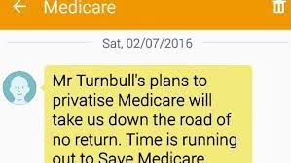
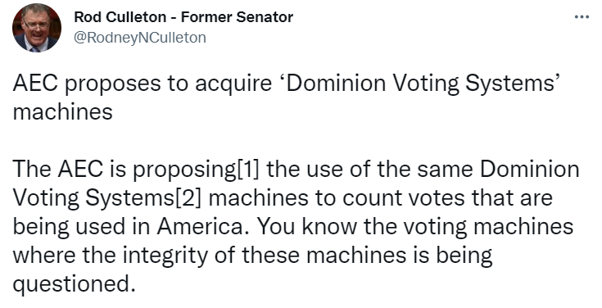
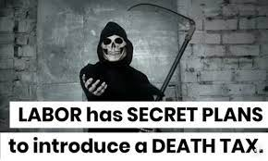
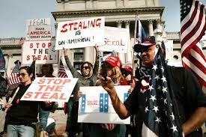

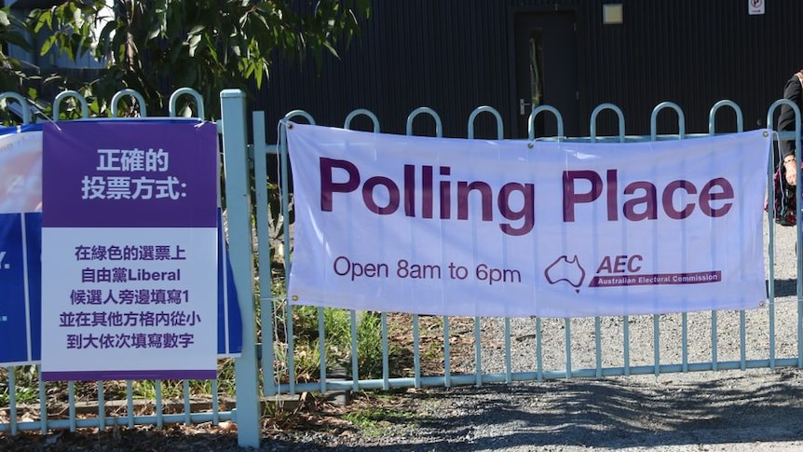
Examples

Slide 26
Impact of misinformation/disinformation
Loss of trust in elections / the AEC
Loss of trust in political parties
Potential impact on voter intention
Least likely outcome: Spencer McKay and Chris Tenove, ‘Disinformation as a Threat to Deliberative Democracy’ (2020) (July) Political Research Quarterly 1

Slide 27
Factors exacerbating the issue
Increased reliance on social media for news
Rise of echo chambers
Lack of engagement between different sides of politics
Increase in amount of fake news generally
Decreasing funding to reputable news sources
Limits on fact checking websites

Slide 28
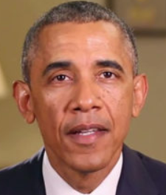
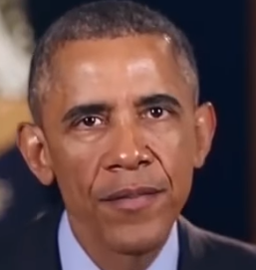
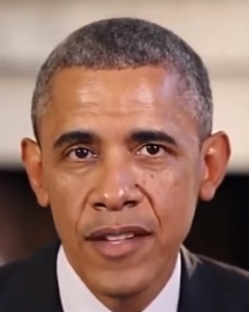
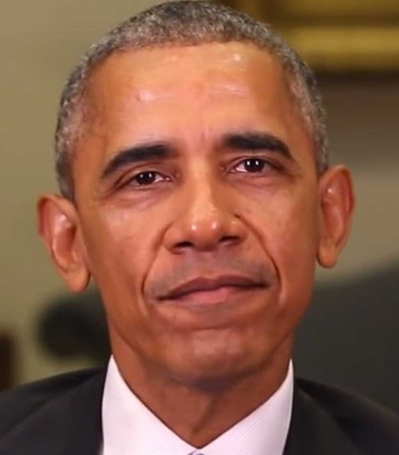
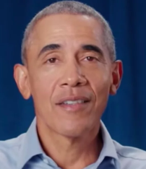
Future Technologies: Political Deepfakes

Slide 29
What could they show?
A video of a candidate making a false policy statement.
A trusted celebrity urging people not to vote for either party (or to donkey vote) in efforts to suppress voters.
A fake video showing a candidate accepting a bribe, cheating on their partner or engaging in criminal activity (such as taking drugs).

Slide 30
Challenges of deepfakes
Hard to disprove
Easily spread
Can be posted from overseas or anonymously and then picked up and reported on
Can enable politicians to claim true footage has been faked

Slide 31
Examples of Deepfakes

Slide 32
Combatting the threat of misinformation

Slide 33
Legislation?
Section 383(1) Electoral Act – Federal Court may grant an injunction where an offence under the Act has occurred or is likely to occur.
329 Misleading or deceptive publications etc.
(1) A person shall not, during the relevant period in relation to an election under this Act, print, publish or distribute, or cause, permit or authorize to be printed, published or distributed, any matter or thing that is likely to mislead or deceive an elector in relation to the casting of a vote

Slide 34
Garbett v Liu
The provision is not concerned with a matter or thing which is misleading or deceptive and which might influence an elector in forming a judgment … It is concerned with the casting of the vote … The distinction is one between the formation of the political or voting judgment of the elector, and its recording or expression (at [31], [36])

Slide 35
SA Electoral Act s 113(2)
A person who authorises, causes or permits the publication of an electoral advertisement (an advertiser) is guilty of an offence if the advertisement contains a statement purporting to be a statement of fact that is inaccurate and misleading to a material extent

Slide 36
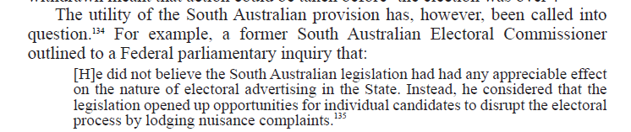
Do truth in political advertising laws work?
Utility?
Foreign interference or anonymous posters
Potential exploitation of the law
Risk of politicising court decisions – what does truth in an election actually mean?

Slide 37
Other pathways for reform
Education
Public fact checking service
Targeted reform
Broadcasting Services Act 1992 sch 2 s 3A
3A Broadcasting of election advertisements
…
the broadcaster must not broadcast an election advertisement in relation to the election during the relevant period as part of the service.

Slide 38
General Principles for Reform
Any laws will need to comply with the IFPC
They should be tailored and targeted to specific threats
The chilling effect of the laws should be carefully considered as should any potential impact on court decisions
Consider how we can assess “truth” in advertising

Slide 39
Questions

